Slide 1
Homework Assignment
You are going to research any artist of your choosing from any time period or genre.
You are going to complete a one page double-spaced biography.
This must include 5 images of artist work
Due Friday
Juxtapoz.com
HiFructose.com
Artslant.com
BeautifulDecay.com
Deitch.com

Slide 2
Color Theory Brainstorm
What types of things does this color remind you of?
What does this color make you feel?

Slide 3
COLOR THEORY

Slide 4
YELLOW

Slide 6
GREEN

Slide 7
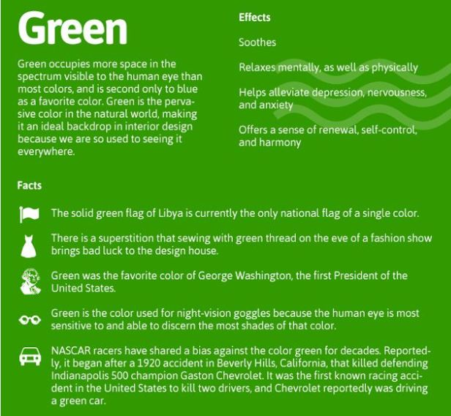

Slide 8
BLUE

Slide 10
PURPLE

Slide 12
PINK

Slide 14
RED

Slide 15
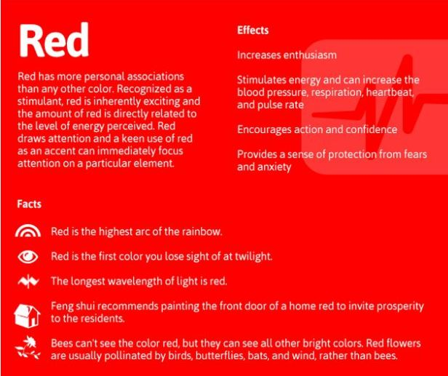

Slide 16
ORANGE

Slide 18
WHITE

Slide 19
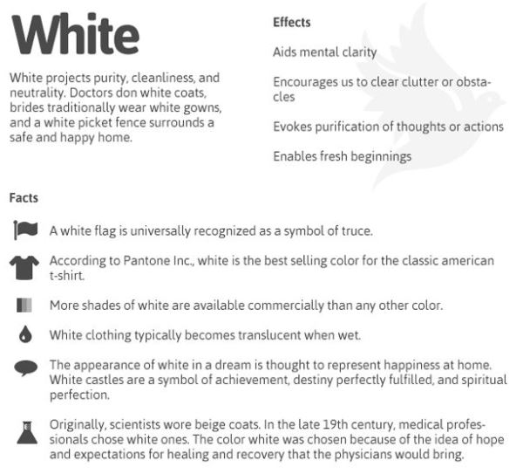

Slide 20
GRAY

Slide 22
BLACK

