Slide 1
ART HISTORY
Brief tales of the vast stories behind artistic styles

Slide 2
Time Periods Used
B.C. = “Before Christ”
a.k.a. Before Christ was Born
A.D. = “Anno Domini”
a.k.a. After Christ was Born

Slide 4
Stone Age: 30,000 B.C. – 2500 B.C.
Characteristics: Cave Paintings, fertility goddesses, and giant structural forms.

Slide 5
Lascaux Cave Paintings
15,000 B.C – Found in Western Europe (what is now France and Spain)
It represents the earliest evidence of the human capacity to interpret and give meaning to surroundings.
Although there is one painting of a human most of the paintings depict animals found in the surrounding landscape, such as horses, bison, mammoths, ibex, aurochs, deer, bears, and wolves.

Slide 6
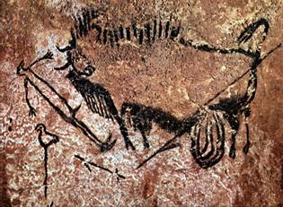

Slide 7
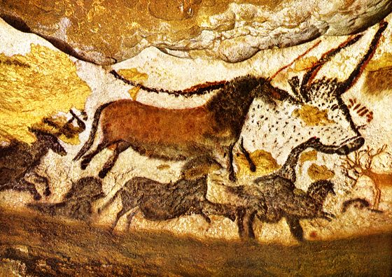

Slide 8
Venus of Willendorf
Found in Willendorf, Austria
Scientists changed the date of origination of this sculpture 3 times until they had a more accurate method of dating.
The newest and most accurate dates are between 24,000 B.C. – 22,000 B.C.
She was constructed by Paleolithic humans. These humans still only had basic instincts and thought processes. Therefore the artist. exaggerated the woman’s body based on how they viewed successful sexual reproduction.

Slide 9
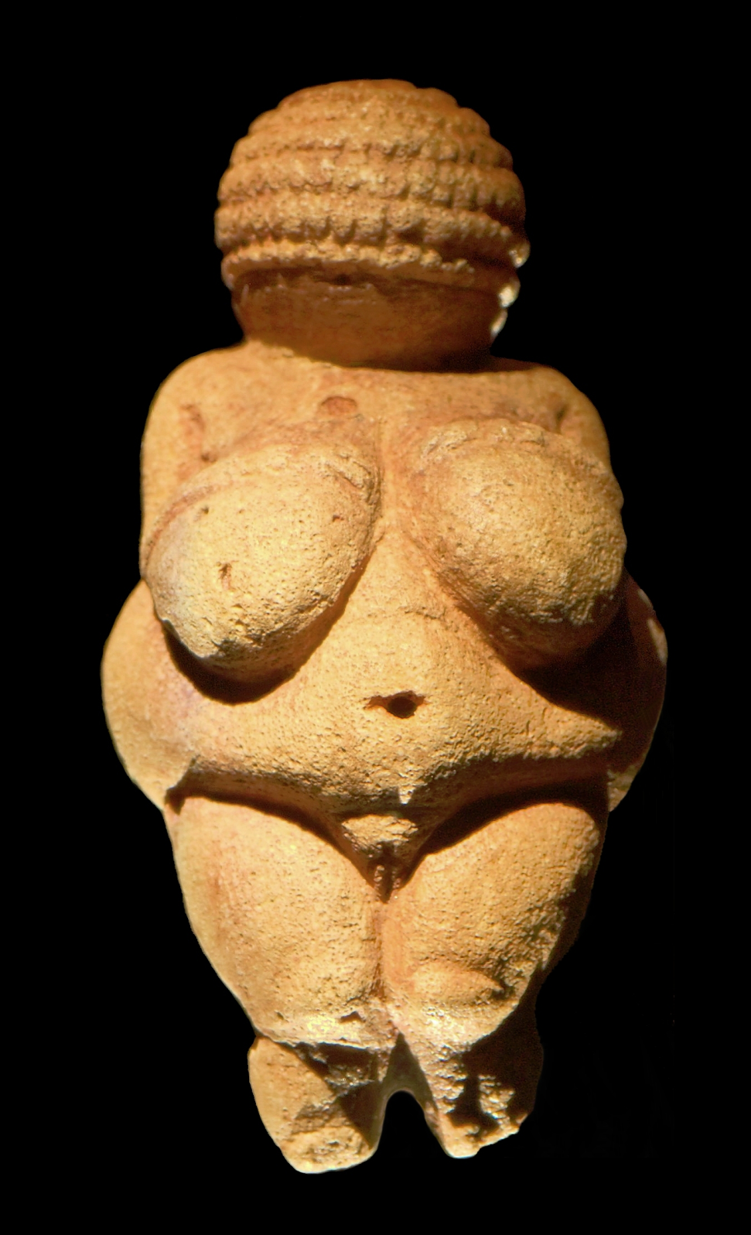
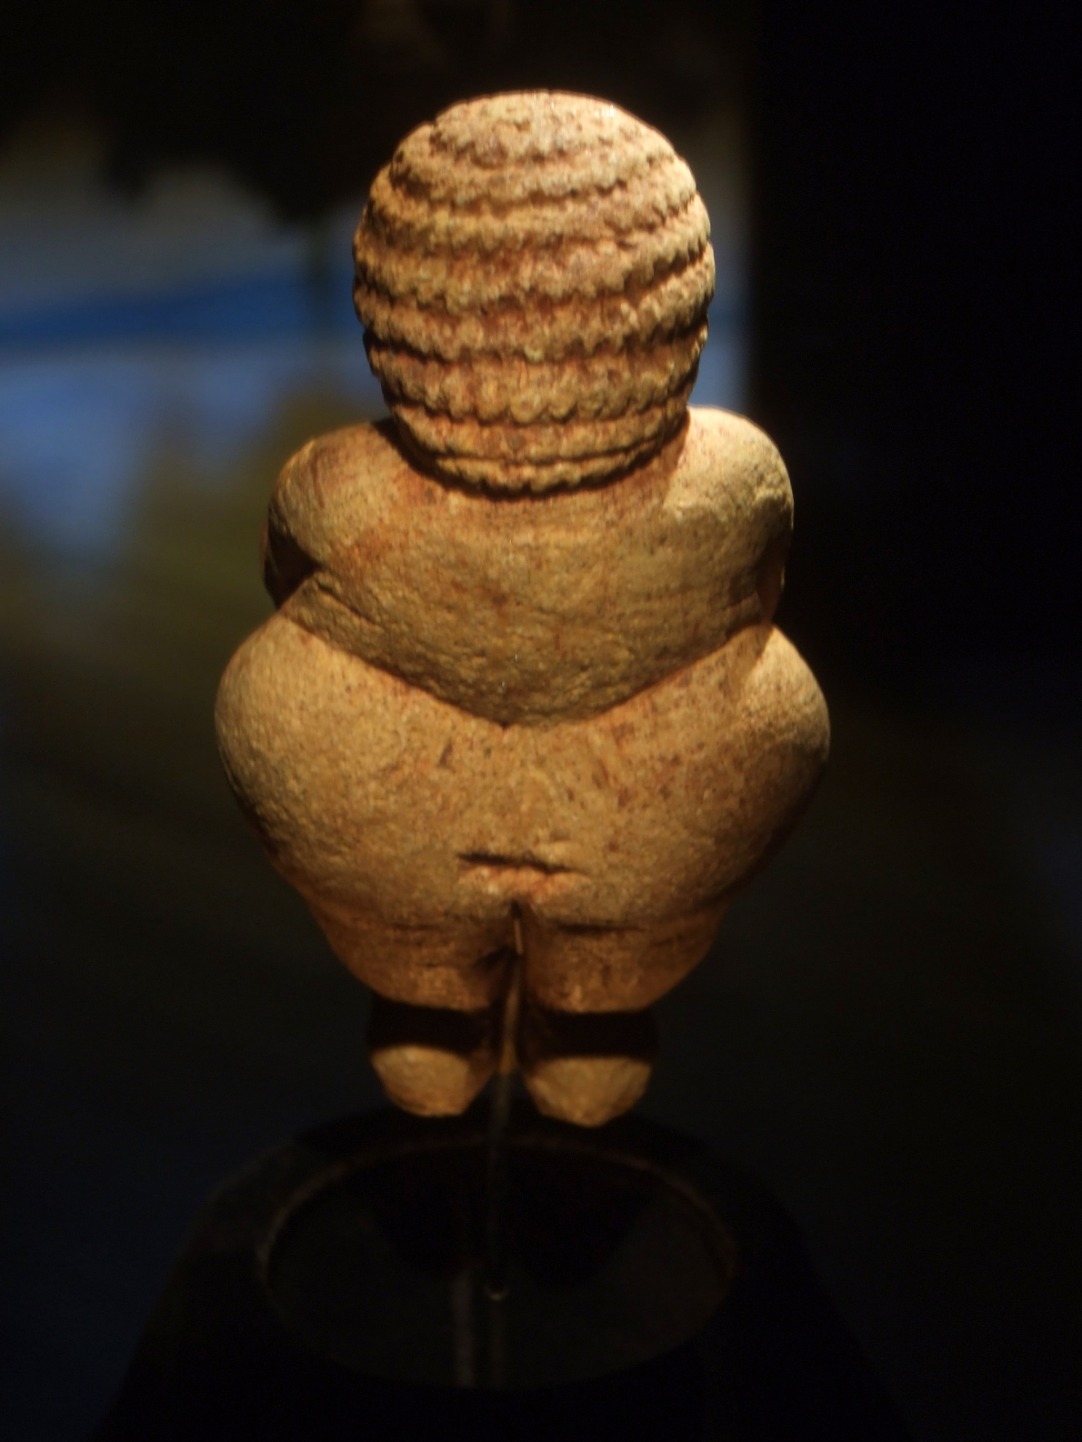

Slide 10
Carbon Dating : What is it?
Science in Art! Itow would be proud

Slide 11
Egyptian Art: 3100 B.C. – 30 B.C.
Characteristics: Art with an Afterlife focus. Pyramids, sculptures, and tomb paintings.

Slide 12
Egyptian Book of the Dead
1600 B.C.
Known to the Egyptians as “Reu nu pert em hru” translated it means “The chapters of coming forth by day.”
It is a collection of chapters made up of magic spells and formulas.
Copies of the book would be made for individuals and then placed in their tomb with them at the time of death.
It can be thought of as the deceased's guidebook to a happy afterlife. The text was intended to be read by the deceased during their journey into the Underworld. It enabled them to overcome obstacles and not lose their way. It did this by teaching passwords, giving clues, and revealing routes that would allow the deceased to answer questions and navigate around hazards. It would also grant the help and protection of the gods while proclaiming the deceased's identity to the gods.

Slide 13
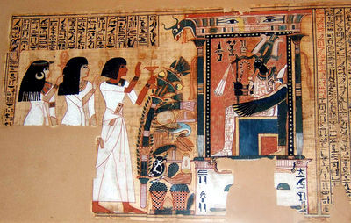

Slide 14
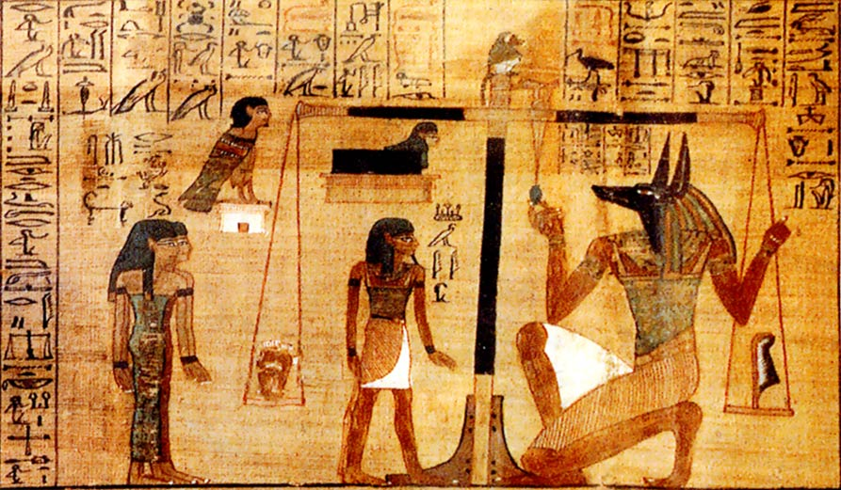

Slide 15
Throne of Tutankhamun
1350 B.C.
Also known as the infamous “King Tut”
He died at the age of 19 from gangrene.
The most elaborate of Tut's thrones, it was made of wood completely covered in gold, and in some places silver, with inlay of coloured semi-precious gems and glass.
The back depicts the seated Tutankhamun, with his queen, Ankhesenamun, anointing him with perfume, beneath a floral pavilion. The rays of the sun god Aten shine on the couple, giving them the sign for life, the Ankh.

Slide 16
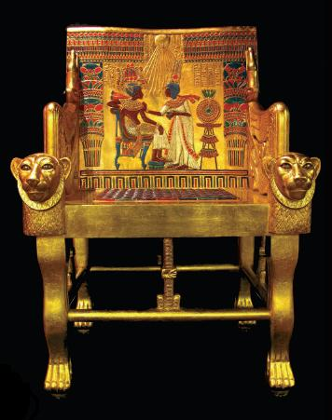

Slide 17
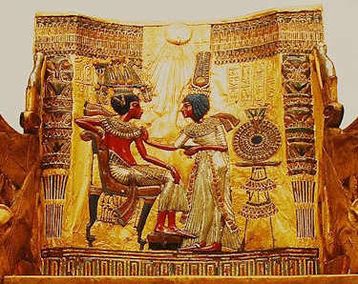

Slide 18
GREEK ART – THE HELLENISTIC PERIOD: 850-31 B.C
Characteristics : Greek idealism – balance and perfect proportions. Architectural order (Doric, Ionic, and Corinthian)

Slide 19
Hellenistic
Relating to Greek history, language, and culture from the death of Alexander the Great to the defeat of Cleopatra and Mark Antony by Octavian in 31 BC. During this period Greek culture flourished, spreading through the Mediterranean and into the Near East and Asia and centering on Alexandria in Egypt and Turkey.
The Ancient Greek word Hellas (Ἑλλάς, Ellás) is the original word for Greece, which the word Hellenistic was derived from.

Slide 20
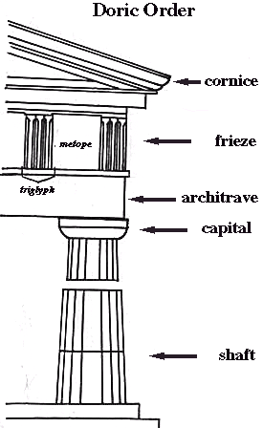
Parthenon
Construction began in 447 B.C
Dedicated to the Greek goddess Athena.
The temple is the general culmination of the Greek architectural style “Doric”
Doric order : one of the orders of classical architecture characterized by a simple and austere column and capital.
Built by the architects Ictinus and Callicrates under the supervision of the sculptor Phidias.
It was created with white marble but has seem much damage and loss over the years.

Slide 21
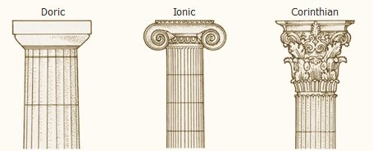

Slide 22
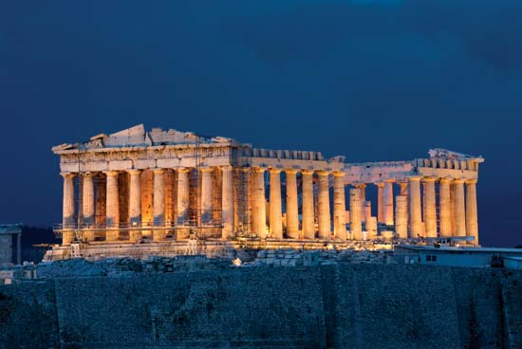

Slide 23
Athena Parthenos
170 B.C
Created by Phidias (also spelled Pheidias)
A modern reproduction of the lost statue of Athena which once resided in the Parthenon of Athens. The 11.5 meter high original, sculpted by Pheidias was made of an inner wooden core covered in ivory and gold. In her right hand stands the goddess Nike. (The Nashville Parthenon, Nashville, Tennessee).
The gold parts could be easily removed in times of financial necessity. Extra embellishments were created with copper, glass, silver, and jewels. And the cost of the statue itself was actually worth more than the Parthenon.
The name Parthenon derives from one of Athena’s many epithets: Athena Parthenos, meaning Virgin

Slide 24
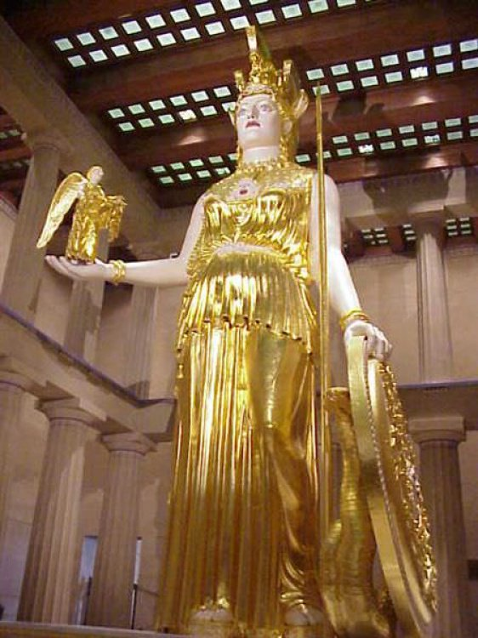

Slide 25
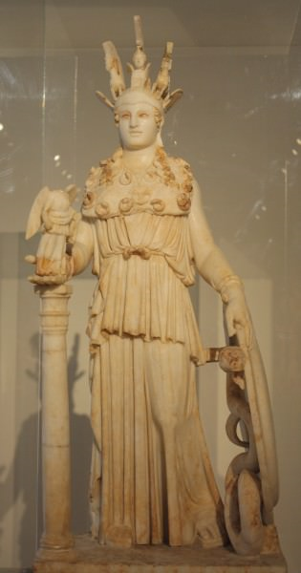

Slide 26
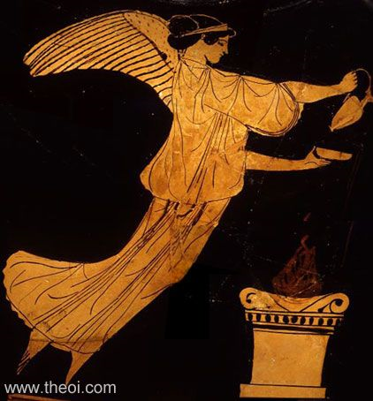
NIKE (Nicé) was the winged goddess of victory--victory both in war and in peaceful competition. When Zeus was gathering allies at the start of the Titan War, Styx brought her four children Nike (Victory), Zelos (Rivalry), Kratos (Cratus Strength) and Bia (Force) into the god's service. Nike was appointed his charioteer and together the four became sentinels of Zeus' throne.
Nike was closely identified with the goddess Athena and at times was little more than an attribute of the goddess.

Slide 27
Roman Art: 500 B.C – 476 A.D.
Roman Realism – Practical and down to earth
The Arch

Slide 28
Roman Colosseum
70-72 A.D.
Size: 620 x 513 feet
Commissioned by Emperor Vespasian as a gift to the Roman people
In 80 A.D. Vespasian’s son Titus officially opened the Colosseum with 100 days of games. This included gladiatorial combats and wild animal fights.
Unlike many earlier amphitheaters, which had been dug into hillsides to provide adequate support, the Colosseum was a freestanding structure made of stone and concrete. The distinctive exterior had three stories of arched entrances–a total of around 80–supported by semi-circular columns. Each story contained columns of a different order (or style): At the bottom were columns of the relatively simple Doric order, followed by Ionic and topped by the ornate Corinthian order.
After four centuries of active use, the magnificent arena fell into neglect, and up until the 18th century it was used as a source of building materials.

Slide 29
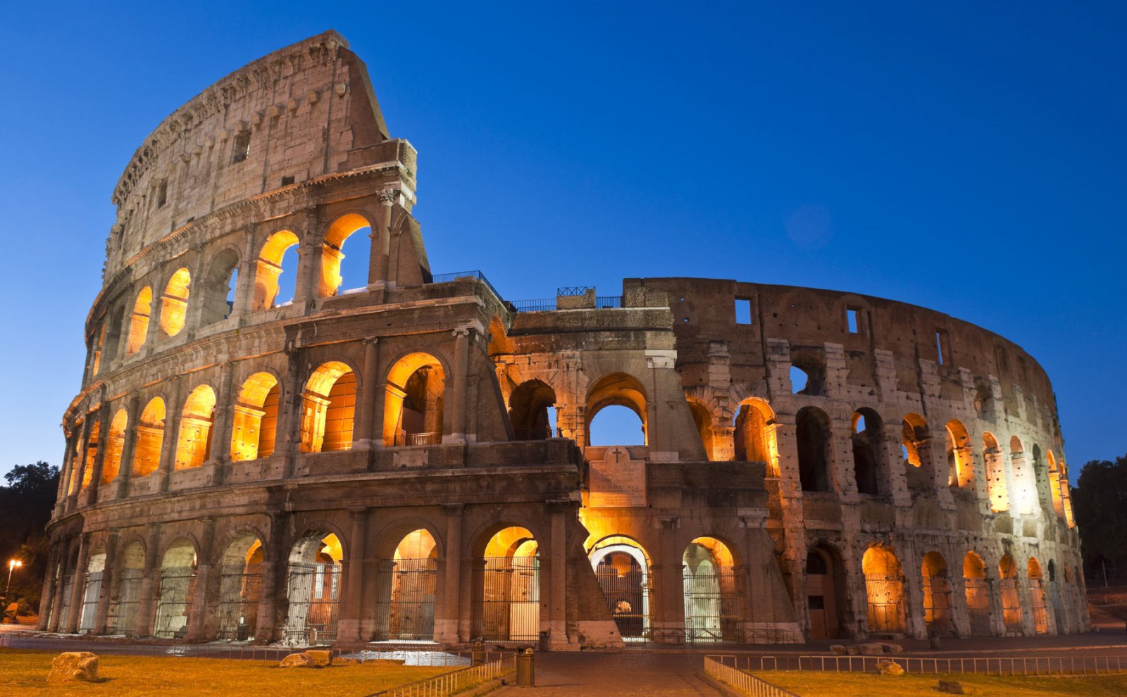

Slide 30
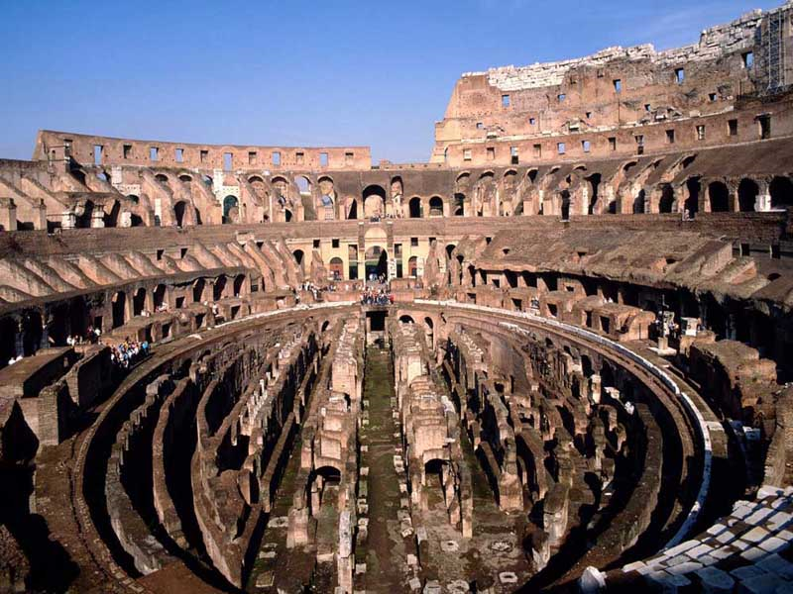

Slide 31
Japanese Art :653 B.C – 1900 A.D
Characteristics: Serene, meditative art, and Arts of the Floating World.

Slide 32
Katsushika Hokusai: The Great Wave at Kanagawa (from a series of 36)
1831 A.D. – 1833 A.D.
Polychrome ink and color on paper (woodblock printing)
Meant to show the compelling force of the contrast between the wave and the mountain. The turbulent wave seems to tower above the viewer, whereas the tiny stable pyramid of Mount Fuji sits in the distance and is stable.
Inspired many future artists as well as classical piano composer Debussy.

Slide 33
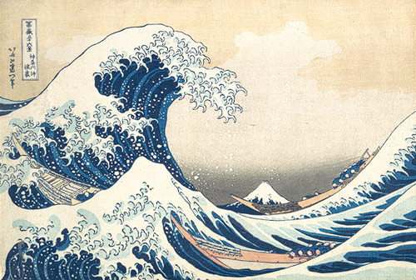

Slide 34
Utagawa Hiroshige : Shimôsa Province – from the series famous places in sixty-odd provinces
1853 A.D.
Japanese wood block print- The text or image was first drawn onto washi (Japanese paper), then glued face-down onto a plank of wood, usually cherry. Wood was then cut away, based on the drawing outlines and ink is applied and the block is printed on paper
Portrayed serene scenes of nature in an enchanting way.

Slide 35
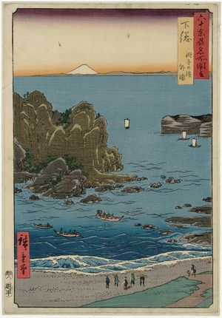

Slide 36
Middle ages : 500 – 1400 A.D
Characteristics: Celtic Art, Romanesque, & Gothic

Slide 37
Giotto – Stigmatization of St. Francis
Created in 1300 A.D
Medium – Tempera on wood
Currently housed in the Louvre (France)
Legend says that St. Francis, during a forty-day period of fasting and praying in the Apennines with his disciples, experienced a vision one morning as the sun was rising. He saw Christ in the form of a six-winged angel in the sky above, and fell to his knees in awe and fear, raising his hands in a gesture of surrender. When the vision ended, he felt sharp pains and discovered he had been given the stigmata (wounds in the hands and feet that the crucified Christ received).
Giotto used many earth tones to communicate a sense of earthly reality.
The light is meant to represent the “holy light” of Christ himself.

Slide 38
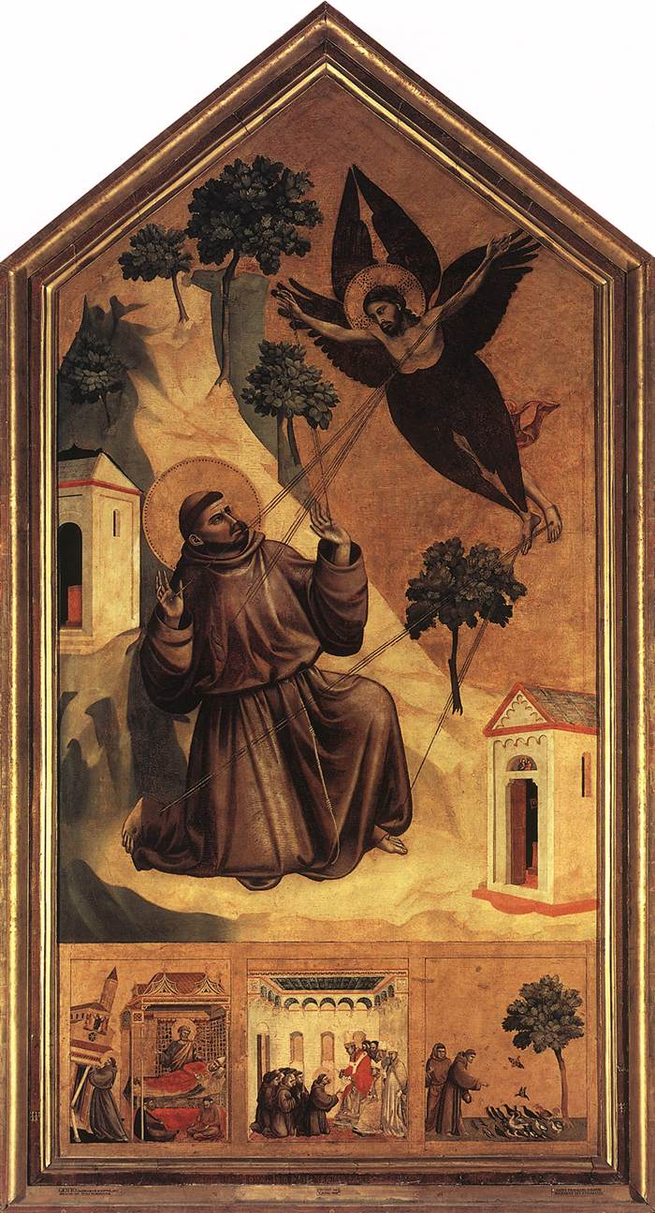

Slide 39
Notre-Dame de Paris
Construction began in 1163 A.D and was completed in 1345 A.D
French – Gothic style architecture
Translation of the name means “Our lady of Paris”
Architects: Pierre de Montreuil and Jean-Baptiste-Antoine
Over its vast history the Cathedral has suffered considerable damage, not least during the French Revolution in 1786. Fortunately it was sympathetically restored and continued to attract attention from around the world.
The Cathedral of Notre Dame is probably best known for its relation to the story of the Hunchback of Notre Dame, made famous by the numerous cartoons and movies inspired by it.

Slide 40
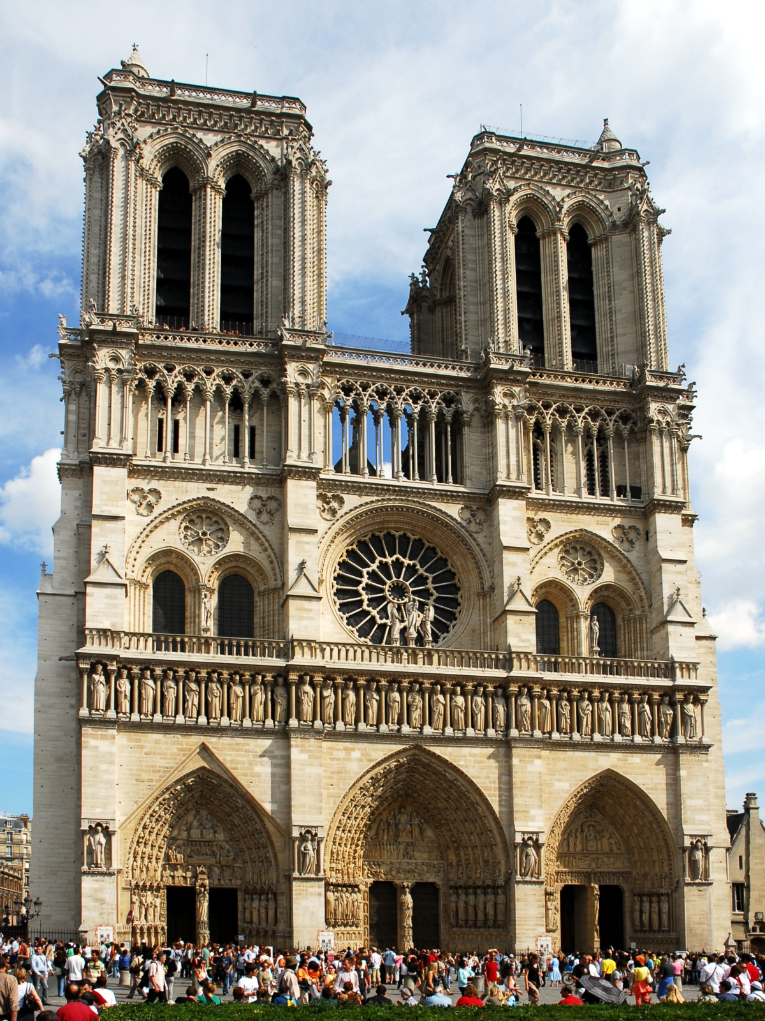

Slide 41
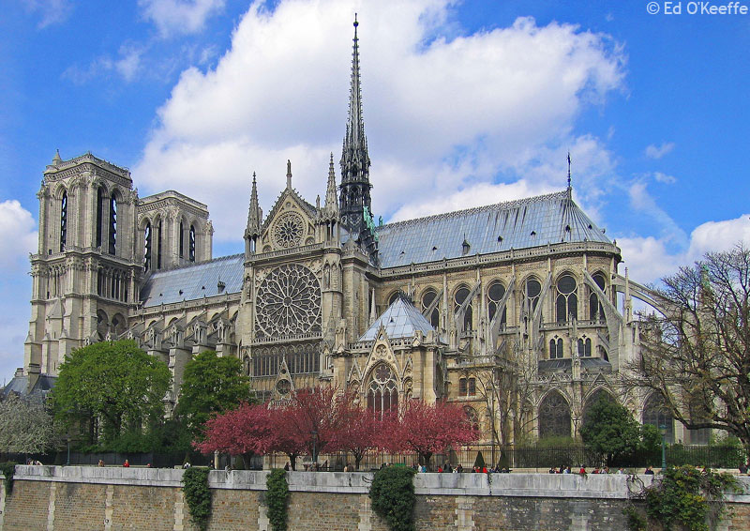

Slide 42
Early and high renaissance : 1400 – 1500 A.D
Characteristics: Rebirth of classical culture

Slide 43
Botticelli – The Birth of Venus
Created 1484-1486 A.D
Tempera on canvas (usually artists worked on wood at the time)
The theme of the Birth of Venus was taken from the writings of the ancient poet, Homer. According to the traditional account, after Venus was born, she rode on a seashell and sea foam to the island of Cythera.
In the painting Venus is prominently depicted in the center, born out of the foam as she rides to shore. On the left, the figure of Zephyrus carries the nymph Aura as he blows the wind to guide Venus.
One importance in this painting is the nudity of Venus. The depiction of nude women was not something that was normally done in this era. For the modeling of this figure, Botticelli turned to an Aphrodite statue.

Slide 44
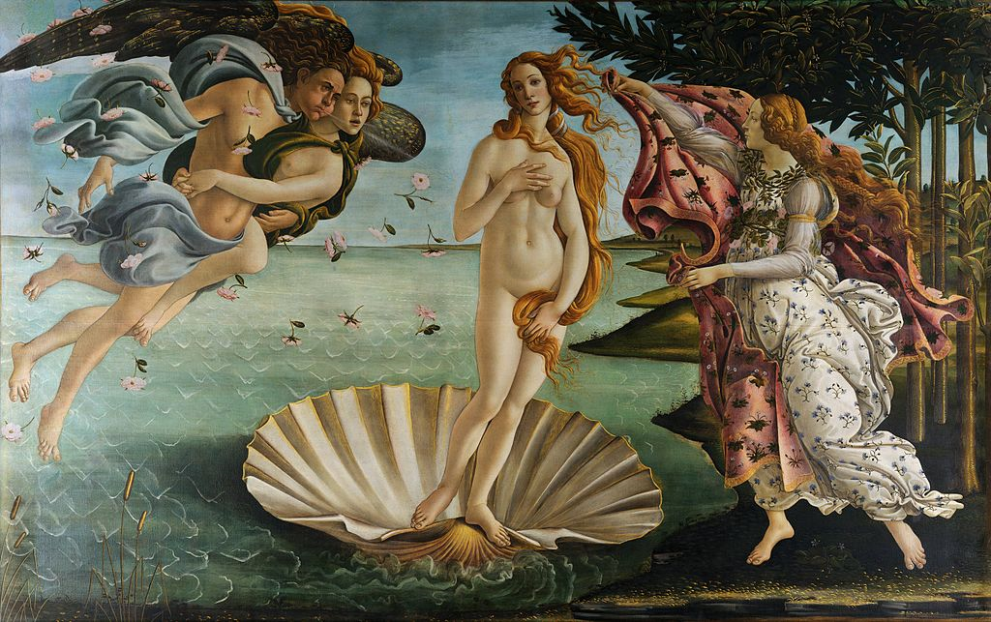

Slide 45
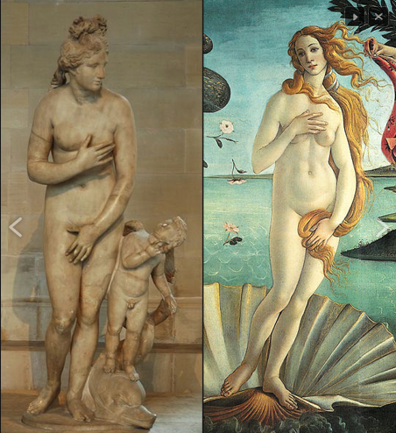

Slide 46
Michelangelo - Creation of Adam
Painted on the ceiling of the Sistine Chapel in the Vatican
1508-1512 A.D
This painting differs from typical creation scenes painted at the time. God is on the right and Adam is on the left.
God is shown inside a floating nebulous form made up of drapery and other figures. The form is supported on angels who fly without wings, but whose flight is made clear by the drapery which whips out from underneath them. God is depicted as an elderly, yet muscular, man with grey hair and a long beard which react to the forward movement of flight. Rather than wearing royal garments and depicted as an all-powerful ruler, he wears only a light tunic which leaves much of his arms and legs exposed.
Unlike the figure of God, who is outstretched, Adam is depicted as a lounging figure who rather lackadaisically responds to God’s imminent touch. This touch will not only give life to Adam, but will give life to all mankind. It is, therefore, the birth of the human race.
Notes:
i

Slide 47
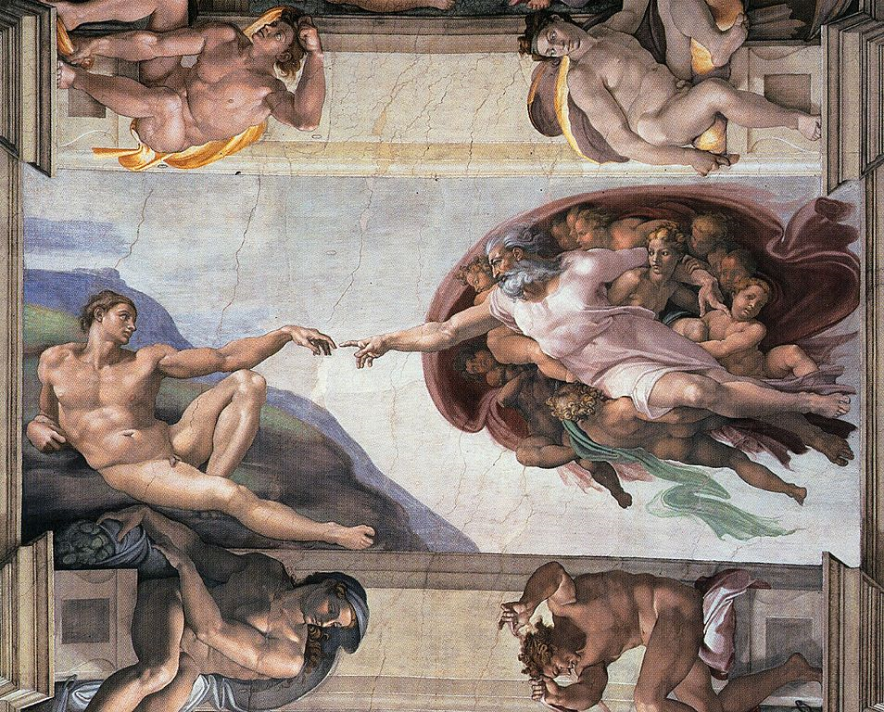

Slide 48
Venetian and northern renaissance : 1430 – 1550 A.D
Characteristics: Renaissance spreads North towards France and the low countries – Poland, Germany, and England

